Slide 1



Slide 2

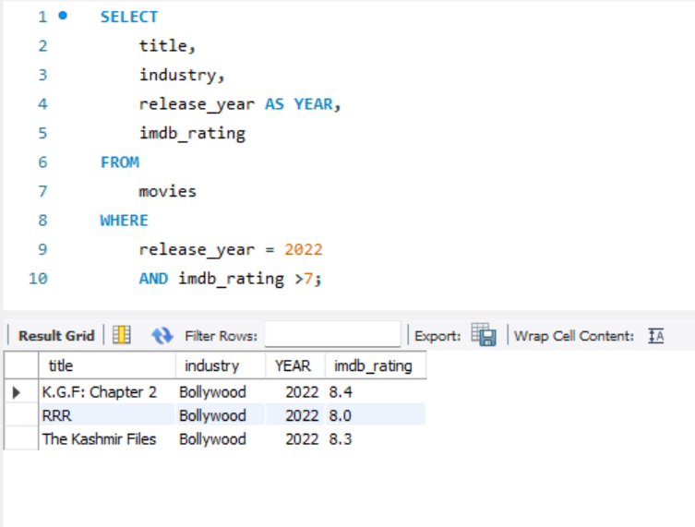
Number of Bollywood Movies Released in 2022 with an IMDb Rating of More than 7

Slide 3
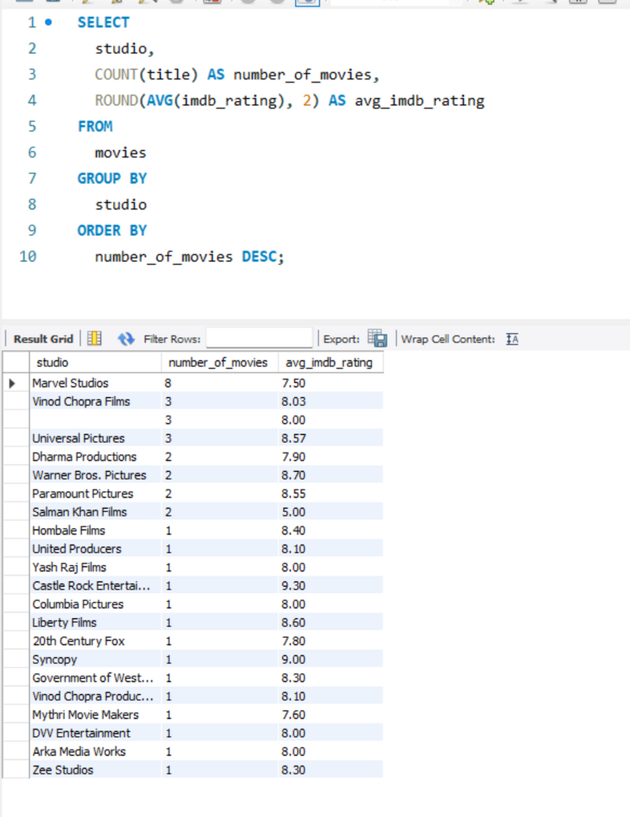
Studio's Total Filmography and Average Rating

Slide 4
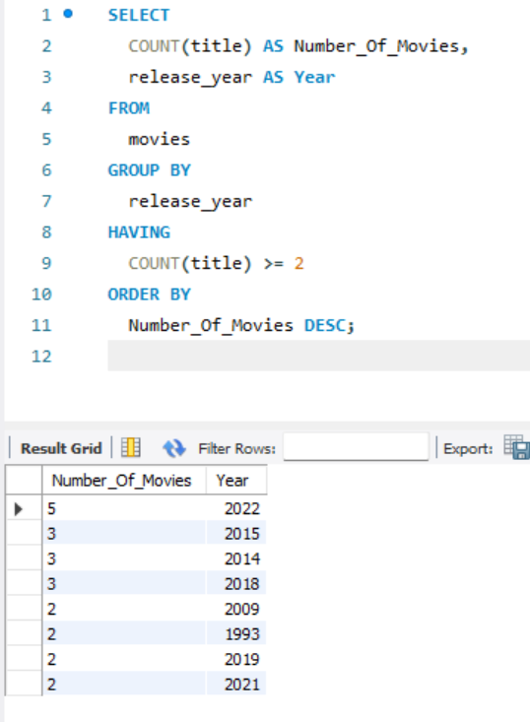
Year with the Highest Number of Movie Releases

Slide 5
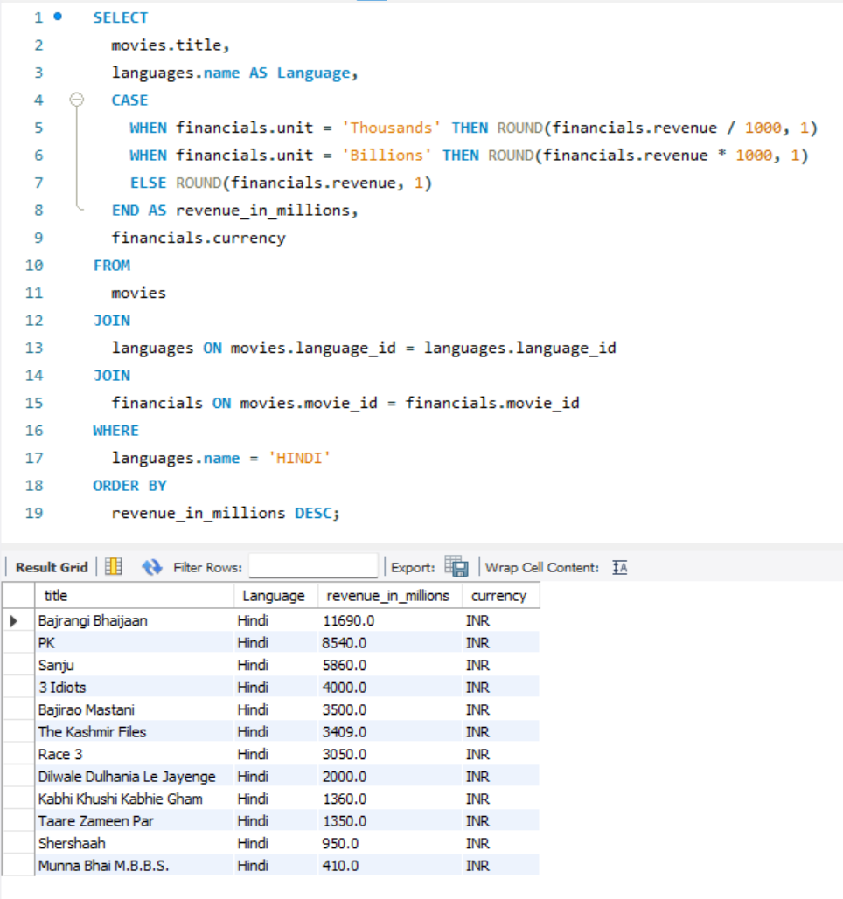
Most Profitable Hindi Movies

Slide 6
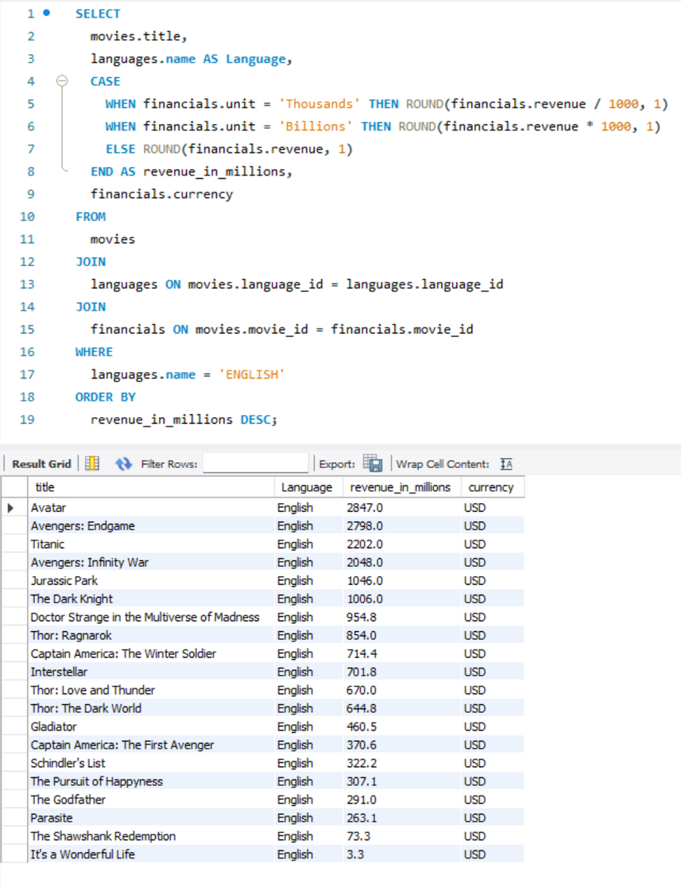
Most Profitable English Movies

Slide 7
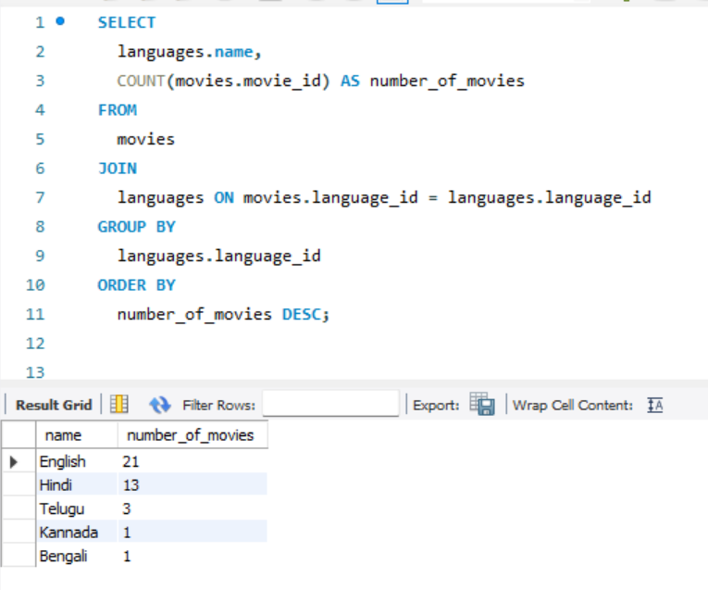
Popularity of Languages in Movies

